Slide 1
Flatcar in the world of Cluster API
Cloud Native Prague Meetup | 24. Sep. 2020
Notes:
Talk title page

Slide 2
Hi, I'm Dongsu
Dongsu Park
Software Engineer, Kinvolk
Github: dongsupark
Email: dongsu@kinvolk.io
Notes:
Speaker introduction page

Slide 3


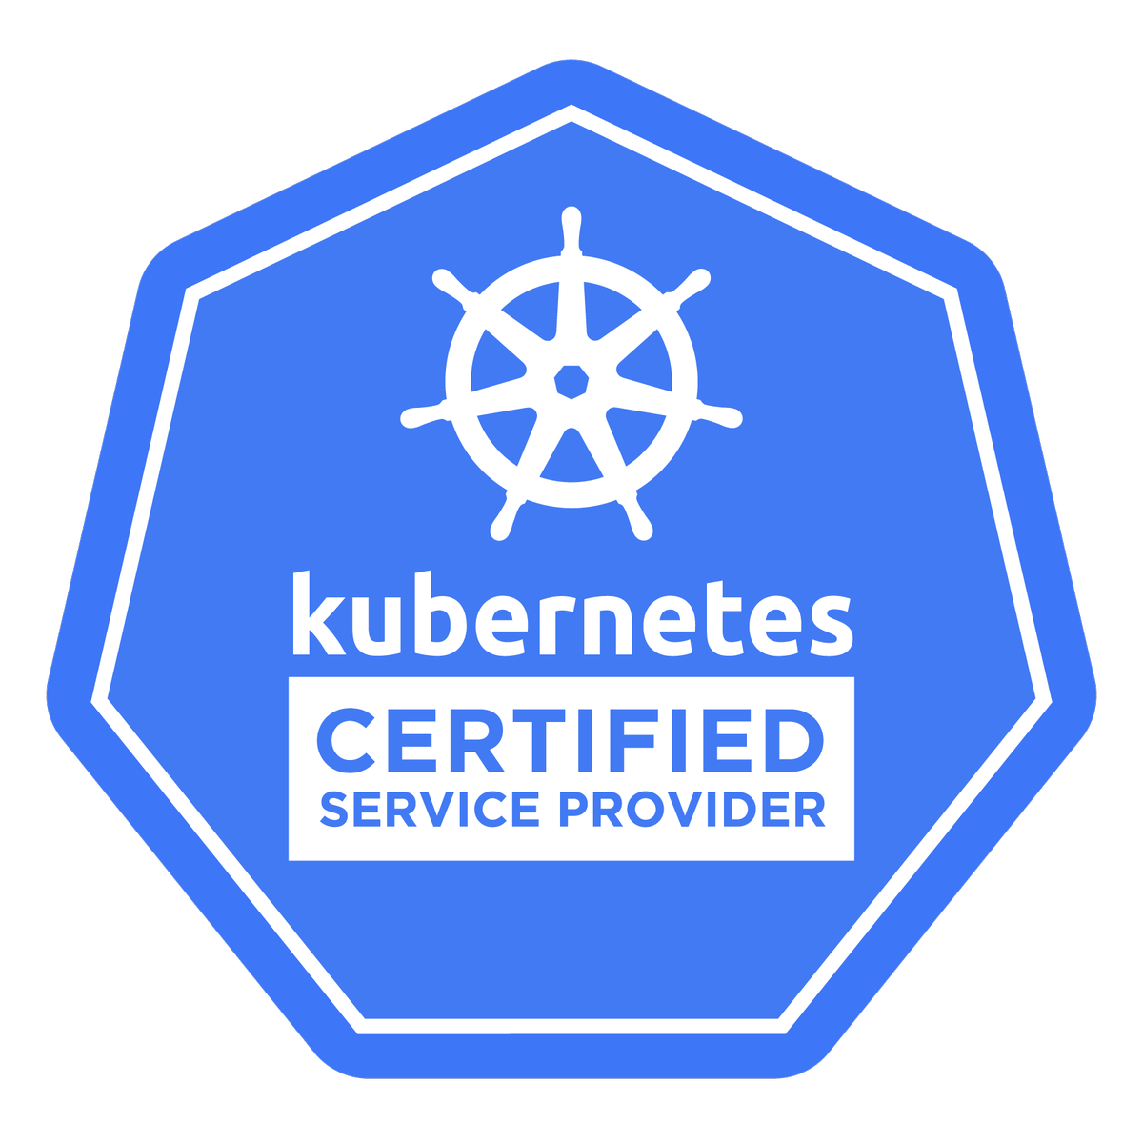










Who is Kinvolk?
Independent, community-driven company since 2015
Technical background: Linux, Security & Containers
Open Source Engineering and Support Services
@kinvolkio

Slide 4








Kinvolk and Open Source
100% Open Source Business Model
gobpf
Modern Kubernetes distro inspired by CoreOS Tectonic
Minimal Linux distro derived from CoreOS Container Linux
Original developers of, and contributors to, numerous other open source projects
@kinvolkio

Slide 5

What is a “Container Linux”?
Just the minimal distribution required for containers
Reduced dependencies
Less base software to manage
Reduced attack surface area
Repeatable deployment without requiring chef/puppet
Immutable file system
Operational simplicity for management at scale
Removes entire category of security threats - e.g. runc vulnerability CVE-2019-5736 kinvolk.io/blog/2019/02/runc-breakout-vulnerability-mitigated-on-flatcar-linux
Automated, streamlined updates
Operational simplicity for management at scale
Easily apply all latest security patches
Rollback partition
@kinvolkio
Notes:
Sub-title with content

Slide 6




Flatcar Heritage
Gentoo ChromeOS
CoreOS Container Linux
Flatcar Container Linux

Slide 7
Cluster API - Introduction
Sub-project of Kubernetes
Addresses challenge when bootstrapping Kubernetes clusters
Migration across multiple cloud providers or regions
Provision of declarative APIs for cluster creation and management
SIG-cluster-lifecycle
Initial release: Apr. 2019
Notes:
Sub-title with content

Slide 8
Cluster API - providers
Bootstrap provider
Kubeadm
Talos
Supports multiple infrastructure providers
AWS
Azure
DigitalOcean
Google Cloud
Packet
VMware
etc.
Notes:
Sub-title with content

Slide 9

Cluster API
Management cluster
Controller managers
Target clusters

Slide 10
Cluster API - Image Builder
Tool to generate base images for Cluster API
Based on Packer and Ansible
Multiple distros
CentOS, Photon, Ubuntu, etc.
Multiple cloud providers
AWS, Azure, DigitalOcean, Google Cloud, VMware OVA, Qemu
Includes tools needed for bootstrapping Kubernetes
Kubeadm, kubectl, kubelet
Notes:
Sub-title with content

Slide 11
Goal for Flatcar
Make image-builder generate Flatcar images
For multiple cloud providers
Integrate Flatcar into the entire Cluster API
Based on images generated by image-builder
For multiple infrastructure providers
Notes:
Sub-title with content

Slide 12
Image Builder for Flatcar - Challenges
No package manager in Flatcar
Container-optimized OS
Number of packages are not available by default
Manual installation needed on the image builder side
Flatcar’s /usr partition is read-only
Not possible to simply copy binaries into /usr/local/bin
Workaround: /opt/bin
Conflict with existing binaries located under read-only partitions
Docker, containerd, cri-tools
Notes:
Sub-title with content

Slide 13
Image Builder for Flatcar - Challenges
Limitations in Ansible
Ansible cannot detect Flatcar as distro
Fixed in Ansible 2.10 (released 22.Sep)
Ansible simply requires packages as either rpm or deb
Sub-optimal for container-optimized OS
PRs in progress
https://github.com/kubernetes-sigs/image-builder/pull/248
https://github.com/kubernetes-sigs/image-builder/pull/371
https://github.com/kinvolk/image-builder/pull/7
Notes:
Sub-title with content

Slide 14
Demo
Notes:
New section page

Slide 15
Cluster API - challenges
Bootstrap provider
Only supports cloud-init by default
No support ignition needed by Flatcar
On-going work to support ignition for bootstrap provider
https://github.com/kubernetes-sigs/cluster-api/issues/3430
https://github.com/kubernetes-sigs/cluster-api/pull/3437
Notes:
Sub-title with content

Slide 16
Cluster API - challenges
Vary across individual infrastructure providers
Different requirements for each provider
AWS: userdata-related parts heavily rely on cloud-init
Multipart mime messages go through the AWS secrets manager
Need to reimplement the userdata parts
https://github.com/kubernetes-sigs/cluster-api-provider-aws/issues/1875
vSphere: network configurations rely on cloud-init
Notes:
Sub-title with content

Slide 17
Cluster API - challenges
Fork ignition for Flatcar (?)
Pros: Can resolve on-going issues around ignition
Cons: result in diverging from upstream ignition
Exploring alternative options
Notes:
Sub-title with content

Slide 18
Conclusion
Flatcar in conventional provisioning world
Bumpy ride ahead
Progress in adjusting image-builder, Packer, Ansible
Make provisioners work without assumptions like package manager
Cluster API for Flatcar
Work in progress, a key focus for the Flatcar team
How to efficiently support ignition
How to deal with different infrastructure providers
Notes:
Sub-title with content

Slide 19
Thank you!
Dongsu Park
Github: dongsupark
Email: dongsu@kinvolk.io
Kinvolk
Blog: kinvolk.io/blog Github: kinvolk Twitter: kinvolkio Email: hello@kinvolk.io
Notes:
Thank you page with contact info

